Slide 1
Food Delivery Data Analysis System
Third Review
Cleaning, Bar Charts and Pie Charts
K. Jaswanthi 25B11AI619
K. Pravallika 26B21AI052
Ch. Siri Varshini 26B21AI017
J. Roshini Sai Deekshitha 25B11AI418
Department
Department of Artificial Intelligence & Machine Learning

Slide 2
Proposal System
Raw dataset
Cleaning
Analysis
Bar charts
Pie charts
50,000 orders
Duplicates and nulls
Counts and averages
5 bar charts
3 pie charts
Review 1 proposed a Python workflow to load, clean, analyse and visualize food-order data.
Review 2 implemented cleaning, EDA and charts on the real dataset.
Review 3 presents the final code: cleaning, bar charts and pie charts on the full dataset.

Slide 3
Abstract
The Food Delivery Data Analysis System is a Python project that analyses 50,000 food-delivery orders: city, cuisine, restaurant, order value, distance, delivery time, rating, payment and status.
Pandas cleans the data (nulls and duplicates) and Matplotlib draws the charts.
Five bar charts and three pie charts show orders by cuisine, city, restaurant, status, payment and delivery time.
Result: a complete pipeline from raw CSV to clean data and clear charts.
49,000
unique records (from 50,000 raw)
11
columns analysed
8
bar and pie charts

Slide 4
Problem Statement
Food delivery platforms collect huge order data, but manual analysis is slow, error-prone and hides patterns. We need to clean the data and show what drives orders using clear charts.
Demand
Delivery time
Which cuisines, cities and payment methods drive orders?
Which cuisines take the longest to deliver on average?
Restaurants
Order status
Which restaurants receive the most orders?
What share of orders are delivered, cancelled or pending?

Slide 5
Dataset Details: Before and After Cleaning
Before cleaning
After cleaning
50,000
11
49,000
11
rows
columns
rows
columns
1,000
0
0
0
duplicate rows
missing values
duplicate rows
missing values
Fields: Order ID, customer age, city, cuisine, restaurant, order value, distance, delivery time, customer rating, payment method, order status.

Slide 6
Missing Values and Duplicate Records
0
How we handled them
Checked nulls column by column with isnull().sum(); the total was 0, so no imputation was needed.
Counted exact duplicate orders with duplicated().sum() and found 1,000 repeated rows.
Removed them with drop_duplicates(), keeping the first copy of each order.
Re-checked shape, nulls and duplicates: 49,000 rows, 0 nulls, 0 duplicates.
If nulls existed: median for numeric columns, mode for categorical columns.
missing values in all 11 columns
1,000
duplicate rows (2% of 50,000)
49,000
unique rows after removal

Slide 7
Code Step by Step: Loading and Cleaning
1
Load: read_csv reads the 50,000 orders into a DataFrame.
import pandas as pd
df = pd.read_csv(
"food_delivery_dataset_50000.csv")
print(df.shape) # (50000, 11)
print(df.isnull().sum()) # all 0
print(df.duplicated().sum()) # 1000
df = df.drop_duplicates()
print(df.shape) # (49000, 11)
2
Shape: Confirms 50,000 rows and 11 columns.
3
Nulls: isnull().sum() gives 0 missing in every column.
4
Duplicates: duplicated().sum() counts 1,000 repeats.
5
Remove: drop_duplicates() leaves 49,000 clean rows.

Slide 8
Code Step by Step: Analysis and Charts
1
Count: value_counts() counts orders per category.
import matplotlib.pyplot as plt
df["Cuisine"].value_counts().plot(
kind="bar")
plt.title("Orders by Cuisine")
plt.show()
df["Payment Method"].value_counts().plot(
kind="pie", autopct="%1.1f%%")
plt.show()
df["City"].value_counts().head()
df["Order Status"].value_counts()
2
Bar chart: Compares cuisines side by side.
3
Pie chart: Shows each payment method's share.
4
City ranking: head() lists the top demand cities.
5
Status: Counts delivered, cancelled and pending.

Slide 9
Expected Outputs vs Actual Outputs
Output | Expected (Review 1) | Actual (Review 3)
Dataset information | Shape and data types | 50,000 rows x 11 columns
Missing-value report | Nulls per column | 0 missing values
Cleaned dataset | No duplicates | 49,000 unique rows
Food category analysis | Most popular cuisine | Biryani: 10,714 orders
Payment analysis | Most-used method | UPI: 23,619 orders
City analysis | Highest-demand city | Warangal: 8,309 orders
Order status | Largest status group | Delivered: 42,290 orders

Slide 10
Visualizations Used and How They Work
Chart | Code used | What it shows
Bar: orders by cuisine | value_counts().plot(kind="bar") | Most popular food: Biryani
Pie: payment methods | value_counts().plot(kind="pie") | Share of UPI, cash, card, wallet
Bar: orders by city | df["City"].value_counts().plot(kind="bar") | Demand by city: Warangal highest
Bar: order status | df["Order Status"].value_counts().plot(kind="bar") | Delivered, cancelled, pending
Bar: orders by restaurant | df["Restaurant"].value_counts().plot(kind="bar") | Demand by restaurant
Bar: delivery time by cuisine | groupby("Cuisine")["Delivery Time"].mean() | Average delivery minutes per cuisine

Slide 11
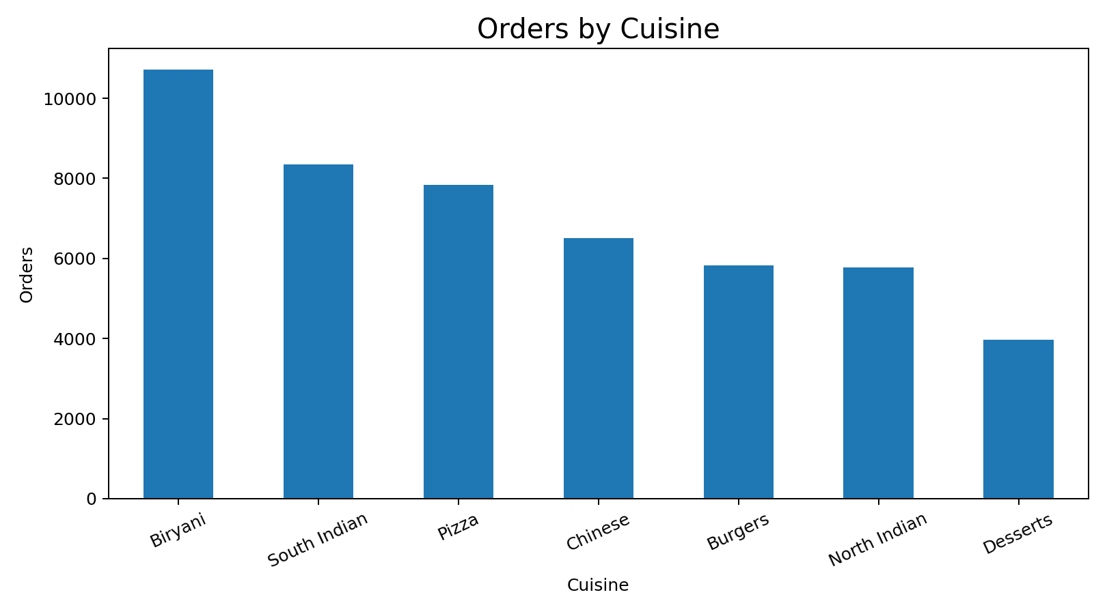
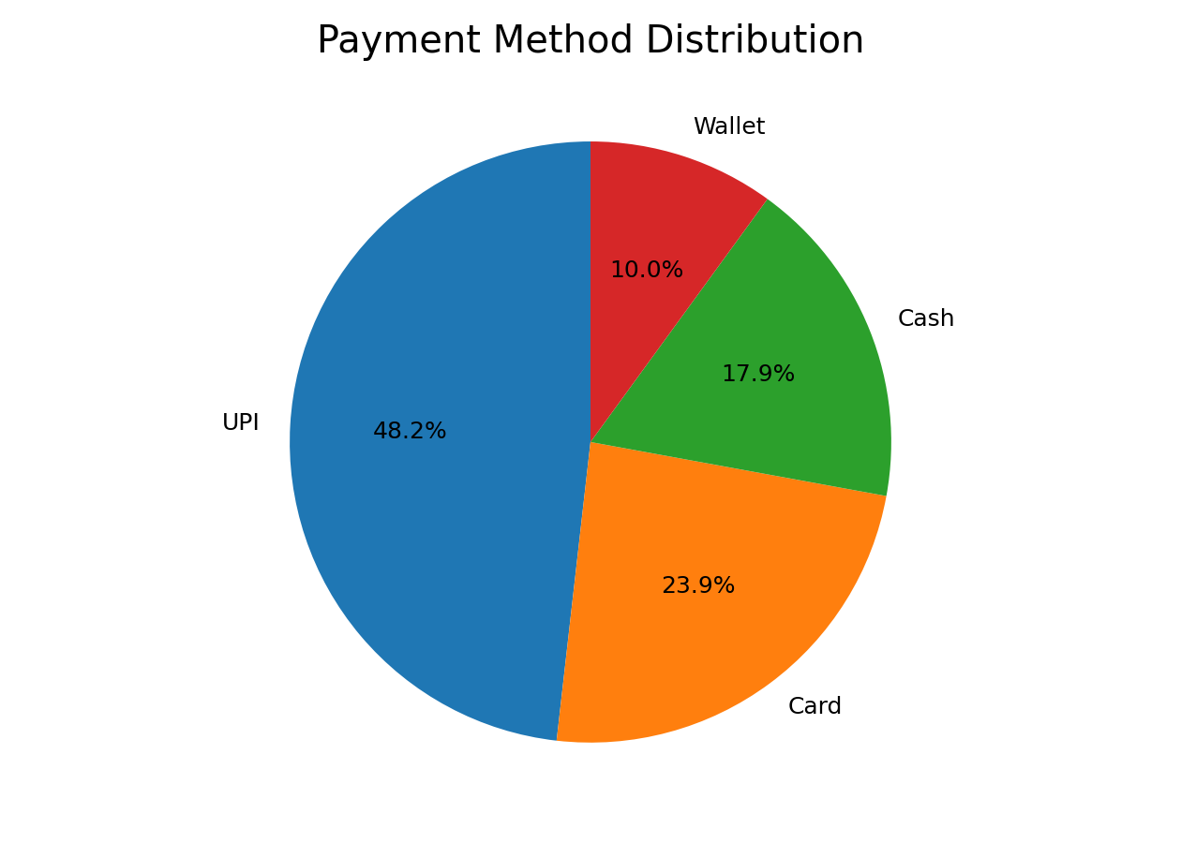
Visualization Outputs
Cuisine bar chart. Biryani leads with 10,714 orders, so menu and stock planning should favour it.
Payment pie chart. UPI is the most-used method with 23,619 orders, so digital payments matter most.

Slide 12
Conclusion
Raw data was cleaned: 50,000 rows became 49,000 unique rows with 0 nulls.
EDA and charts showed Biryani, UPI, Warangal and Delivered orders as the top groups.
Five bar charts and three pie charts present orders by cuisine, city, restaurant, status, payment and delivery time.

Slide 13
THANK YOU

